Slide 1
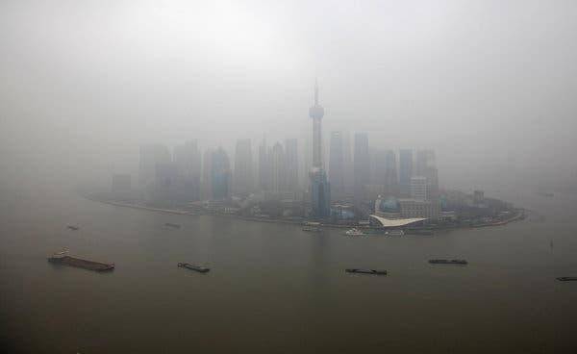
Air Pollution in China
API 222 Machine Learning and Big Data Analytics
Predicting PM2.5 from other pollution predictors
Group 5: Jonathan Hudgins, Januardy Djong,
Marina Kusumawardhani
Photo: New York Times

Slide 2
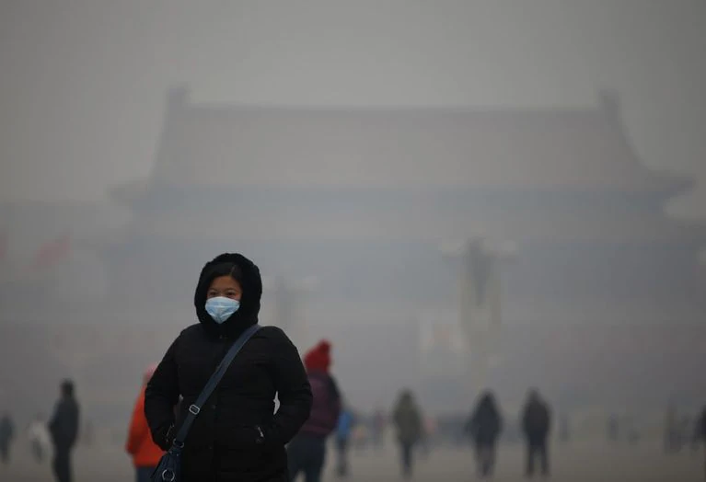
Problem Motivation
Leading environmental threat to human health: estimated to be responsible for 6.4 million deaths worldwide in 2015.
Particulate Matter 2.5 (PM2.5): small enough to be inhaled deep into the lungs.
The Center for Disease Control (CDC): lowering PM levels would prevent deaths, mostly from heart attacks and heart disease.
Method:
Machine Learning to better predict PM2.5
Analyzing atmospheric data gathered over 4 years from Beijing, China.
Photo: Washington Post
Sources:
“Can Air Pollution Be Predicted?,” accessed November 16, 2019, https://www.iqair.com/us/blog/air-quality/can-air-pollution-be-predicted.
“Environments Tracking Air Quality - Health Impacts of Fine Particles in Air - CDC Tracking Network,” 2019 https://ephtracking.cdc.gov/showAirHIA.action.
“Environments Tracking Air Quality - Health Impacts of Fine Particles in Air - CDC Tracking Network.”

Slide 3
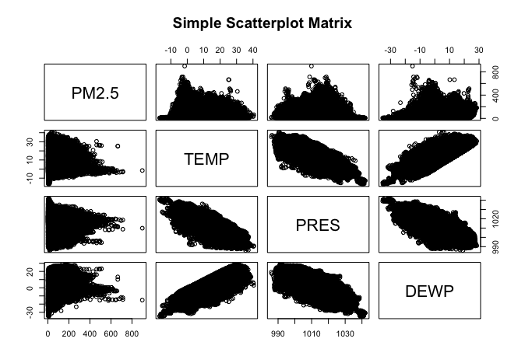
Experimented Models
Linear models provided really poor MSE values with this dataset.
KNN provided better MSE on the test set (704) but Boosting was even better, with an MSE of (607).
After exploring multiple machine learning methods in R Studio, we found the best model for predicting PM2.5 levels is Random Forest.

Slide 4
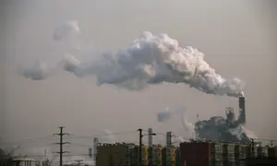
Main Results (preliminary)
Utilizing Random Forest and including both pollutants and weather data : RMSE = ~17.
Most PM2.5 air quality apps divide the PM2.5 levels into blocks of 50: our model gets us well inside this measurement.
Useful information for the U.S. Embassy in Beijing to help augment their real-time observation equipment.
Next step of experiment: utilizing RF using only weather data (no other pollutants), possibly to include some feature engineering
Could also be useful to predict PM2.5 in places where no pollution observation equipment exists.
Photo: The Guardian

Slide 5

Suggestions and Challenges for Adoption
Ideally, U.S. Embassy in Beijing to implement ML in addition to their observation equipment.
Other alternative: use commercial vendors like AirVisual for the software (but they would need access to meteorological data from the Embassy which is currently unavailable) => require the Embassy to acquire additional meteorological observation instruments.
Other alternative: the Chinese government use our model in areas where meteorological equipment is available but PM2.5 observation equipment may not be => may be difficult due to political sensitivities of air pollution issues in China.
US Embassy in Beijing. Photo: National Museum of American Diplomacy

